Slide 1
SQL JOIN

Slide 2

SQL JOIN
SQL JOIN
As the name shows, JOIN means to combine something. In case of SQL, JOIN means "to combine two or more tables".
The SQL JOIN clause takes records from two or more tables in a database and combines it together.
ANSI standard SQL defines five types of JOIN :
inner join,
left outer join,
right outer join,
full outer join, and
cross join.

Slide 3
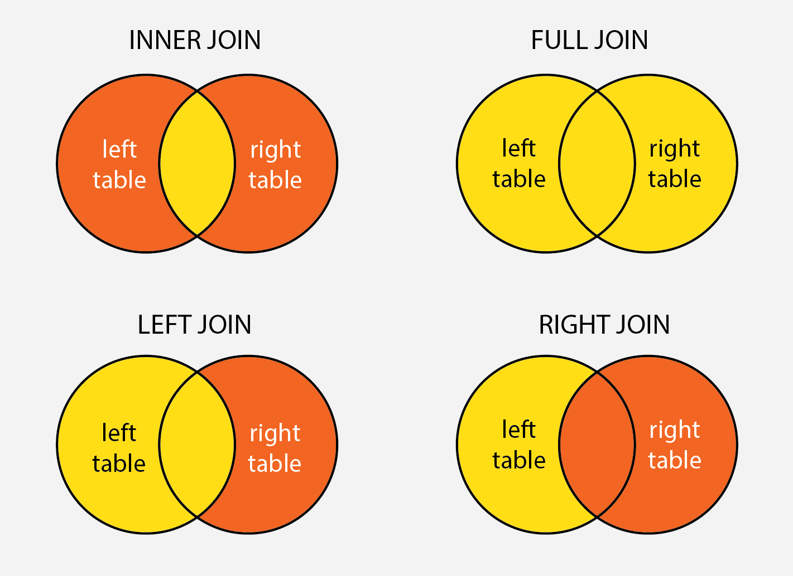
SQL JOIN

Slide 4
SQL JOIN
Why SQL JOIN is used?
If you want to access data from more than one tables through a select statement.
If you want to combine two or more tables then SQL JOIN statement is used. It combines rows of that tables in one table and one can retrieve the information by a SELECT statement.
The joining of two or more tables is based on common field between them.
SQL INNER JOIN also known as simple join is the most common type of join.

Slide 5
SQL JOIN
1.Staff table
ID | Staff_NAME | Staff_AGE | STAFF_ADDRESS | Monthly_Package
1 | ARYAN | 22 | MUMBAI | 18000
2 | SUSHIL | 32 | DELHI | 20000
3 | MONTY | 25 | MOHALI | 22000
4 | AMIT | 20 | ALLAHABAD | 12000

Slide 6
SQL JOIN
2.Payment table
Payment_ID | DATE | Staff_ID | AMOUNT
101 | 30/12/2009 | 1 | 3000.00
102 | 22/02/2010 | 3 | 2500.00
103 | 23/02/2010 | 4 | 3500.00

Slide 7
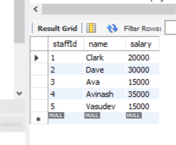
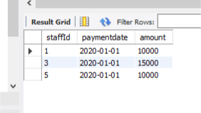
SQL JOIN
So if you follow this JOIN statement to join these two tables.
SELECT Staff_ID, Staff_NAME, Staff_AGE, AMOUNT
FROM STAFF s, PAYMENT p
WHERE s.ID =p.STAFF_ID;

Slide 8
SQL JOIN
Inner Join : Syntax
Select * from lefttable
Inner join righttable
on lefttable.field=righttable.field

Slide 9
SQL JOIN
SQL OUTER JOIN
In the SQL outer JOIN all the content of the both tables are integrated together either they are matched or not.
If you take an example of employee table
Outer join of two types:
1.Left outer join (also known as left join): this join returns all the rows from left table combine with the matching rows of the right table. If you get no matching in the right table it returns NULL values.
2.Right outer join (also known as right join): this join returns all the rows from right table are combined with the matching rows of left table .If you get no column matching in the left table .it returns null value.

Slide 10
SQL JOIN
SQL LEFT JOIN
The SQL left join returns all the values from the left table and it also includes matching values from right table, if there are no matching join value it returns NULL.
BASIC SYNTAX FOR LEFT JOIN:
SELECT table1.column1, table2.column2....
FROM table1
LEFT JOIN table2
ON table1.column_field = table2.column_field;

Slide 11
SQL JOIN
CUSTOMER TABLE:
ID | NAME | AGE | SALARY
1 | ARYAN | 51 | 56000
2 | AROHI | 21 | 25000
3 | VINEET | 24 | 31000
4 | AJEET | 23 | 32000
5 | RAVI | 23 | 42000

Slide 12
SQL JOIN
ORDER TABLE:
O_ID | DATE | CUSTOMER_ID | AMOUNT
001 | 20-01-2012 | 2 | 3000
002 | 12-02-2012 | 2 | 2000
003 | 22-03-2012 | 3 | 4000
004 | 11-04-2012 | 4 | 5000

Slide 13
SQL JOIN
join these two tables with LEFT JOIN:
SQL SELECT ID, NAME, AMOUNT,DATE
FROM CUSTOMER
LEFT JOIN ORDER
ON CUSTOMER.ID = ORDER.CUSTOMER_ID;

Slide 14
SQL JOIN
This will produce the following result:
ID | NAME | AMOUNT | DATE
1 | ARYAN | NULL | NULL
2 | AROHI | 3000 | 20-01-2012
2 | AROHI | 2000 | 12-02-2012
3 | VINEET | 4000 | 22-03-2012
4 | AJEET | 5000 | 11-04-2012
5 | RAVI | NULL | NULL

Slide 15
SQL JOIN
SQL RIGHT JOIN
The SQL right join returns all the values from the rows of right table. It also includes the matched values from left table but if there is no matching in both tables, it returns NULL.
Basic syntax for right join:
SELECT table1.column1, table2.column2.....
FROM table1
RIGHT JOIN table2
ON table1.column_field = table2.column_field;

Slide 16
SQL JOIN
Previous two tables with SQL RIGHT JOIN:
SQL> SELECT ID,NAME,AMOUNT,DATE
FROM CUSTOMER
RIGHT JOIN ORDER
ON CUSTOMER.ID = ORDER.CUSTOMER_ID;

Slide 17
SQL JOIN
Output:
ID | NAME | AMOUNT | DATE
2 | AROHI | 3000 | 20-01-2012
2 | AROHI | 2000 | 12-02-2012
3 | VINEET | 4000 | 22-03-2012
4 | AJEET | 5000 | 11-04-2012

Slide 18
SQL JOIN
SQL FULL JOIN
The SQL full join is the result of combination of both left and right outer join and the join tables have all the records from both tables. It puts NULL on the place of matches not found.
SQL full outer join and SQL join are same. generally it is known as SQL FULL JOIN.
What is SQL full outer join?
SQL full outer join is used to combine the result of both left and right outer join and returns all rows (don't care its matched or unmatched) from the both participating tables.

Slide 19
SQL JOIN
Syntax for full outer join:
SELECT *
FROM table1
FULL OUTER JOIN table2
ON table1.column_name = table2.column_name;
Note: here table1 and table2 are the name of the tables participating in joining and column_name is the column of the participating tables.

Slide 20
SQL JOIN
table_B
table_A
A | M
1 | m
2 | n
4 | o
A | N
2 | p
3 | q
5 | r

Slide 21
SQL JOIN
Because this is a full outer join so all rows (both matching and non-matching) from both tables are included in the output. Here only one row of output displays values in all columns because there is only one match between table_A and table_B.
Resulting table
A | M | A | N
2 | n | 2 | p
1 | m | - | -
4 | o | - | -
- | - | 3 | q
- | - | 5 | r

Slide 22
SQL JOIN
SQL Cross Join
When each row of first table is combined with each row from the second table, known as Cartesian join or cross join. In general words we can say that SQL CROSS JOIN returns the Cartesian product of the sets of rows from the joined table.
We can specify a CROSS JOIN in two ways:
Using the JOIN syntax.
the table in the FROM clause without using a WHERE clause.
SYNTAX of SQL Cross Join
SELECT * FROM [TABLE1] CROSS JOIN [TABLE2]
OR
SELECT * FROM [ TABLE1] , [TABLE2]

Slide 23
SQL JOIN
Table2 - Departments
Table1 - MatchScore
Player | Department_id | Goals
Franklin | 1 | 2
Alan | 1 | 3
Priyanka | 2 | 2
Rajesh | 3 | 5
Department_id | Department_name
1 | IT
2 | HR
3 | Marketing
SQL Statement:
SELECT * FROM MatchScore CROSS JOIN Departments

Slide 24
SQL JOIN
Player | Department_id | Goals | Depatment_id | Department_name
Franklin | 1 | 2 | 1 | IT
Alan | 1 | 3 | 1 | IT
Priyanka | 2 | 2 | 1 | IT
Rajesh | 3 | 5 | 1 | IT
Franklin | 1 | 2 | 2 | HR
Alan | 1 | 3 | 2 | HR
Priyanka | 2 | 2 | 2 | HR
Rajesh | 3 | 5 | 2 | HR
Franklin | 1 | 2 | 3 | Marketing
Alan | 1 | 3 | 3 | Marketing
Priyanka | 2 | 2 | 3 | Marketing
Rajesh | 3 | 5 | 3 | Marketing

